Slide 1
Software Construction & Development
Week 09
Abeeha Sattar

Slide 2
log4j2

Slide 3
What is Logging?
Logging is basically the act of keeping a log.
Logs are stored in log files, or you can print them if you want, but…

Slide 4
Consider this Scenario
Suppose you are developing an E-commerce application. There will be many modules but just to make it simple let’s suppose you have three modules to develop – searchProduct, calculateValue, and payment. A user will search for a product and add it to the cart. Then cart value will be calculated and the user will be navigated to the payment page.
Taken from:
http://makeseleniumeasy.com/2021/03/11/log4j2-tutorial-1-introduction-to-apache-log4j2/#Why_we_need_Loggers
Notes:
Data will be moved across modules. While developing you must have to add some standard print commands so that you could track the flow. For example – items are searched correctly, desired items are added to the cart, total payable amount, etc. These standard print statements help you to analyze the code flow and catch if there is any unexpected result or break in the flow. In short a kind of log, it is. These logs will be very important for development, testing, and finding the place of occurrence of a problem later.
The use of standard print statements is not a good way of logging. It will be really difficult to track these print statements in a pool of extra logs coming from other sources (Maven, Gradle, libraries, etc). You may also want to store logs in an external file or keep track of old logs then it may not be easy. The standard print statements will not help much in a production environment.

Slide 5
Logging APIs
Log4j
Log4j2
Java’s own logging API
You can download log4j2 from here:
https://logging.apache.org/log4j/2.x/download.html
You will need:
log4j-api-<version>.jar
log4j-core-<version>.jar

Slide 6
Log Levels
ALL – To log all events.
DEBUG – A general debugging event.
ERROR – An error in the application, possibly recoverable.
FATAL – A severe error that will prevent the application from continuing.
INFO – An event for informational purposes.
TRACE – A fine-grained debug message, typically capturing the flow through the application.
WARN – An event that might possibly lead to an error.
OFF – No events will be logged.

Slide 7
Log Order for Log4j
ALL < TRACE < DEBUG < INFO < WARN < ERROR < FATAL
By default Log4j assigns the root logger to Level.ERROR and those logs will be printed on the standard console.
Notes:
If we mention log level as INFO then all INFO, WARN, ERROR and FATAL events will be logged.
If we mention log level as WARN then all WARN, ERROR and FATAL events will be logged.
In simple terms, all the levels below the specified level including the specified level will be considered.

Slide 8
Appenders
We can specify destinations to keep event logs. We may want to print those logs in the console or any external file.
Appenders usually are only responsible for writing the event data to the target destination.

Slide 9
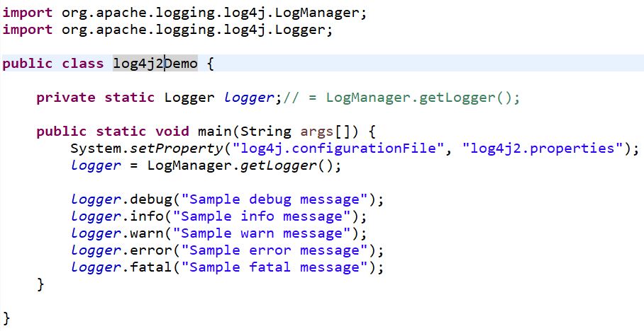
Code Example

Slide 10
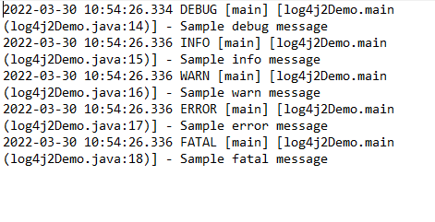
Output (log file)

Slide 11
Code Example
You can find an example code over here:
https://github.com/amodmahajan2016/MSE_Log4j2ExampleCodes/tree/master/src/main/resources

Slide 12
Video for Reference
https://www.youtube.com/watch?v=18V5Qc-CXZk&t=708s

Slide 13
Fin.

